Slide 1
Real-Time Financial Fraud Detection & Monitoring System
Team Members :
Data Ingestion Engineer - Bhagath G
Transformation Engineer - Jothilingam D
ML Engineer - Devesh Raaj
Dashboard & Documentation Engineer - Angad Kumar

Slide 2
Project Overview
The Real-Time Financial Fraud Detection & Monitoring System is an enterprise-grade streaming analytics platform designed to detect, score, and monitor suspicious financial transactions in real time using modern data engineering and machine learning practices.
Project Objective & Key Outcomes :
Detect fraudulent transactions in real time
Use streaming data processing
Apply machine learning for anomaly detection
Provide dashboards for fraud monitoring
Faster fraud detection Improved visibility Scalable architecture

Slide 3
Solution Architecture
Pipeline Flow:
Streaming Data Generator → Auto Loader → Bronze Layer → Silver Layer → ML Scoring → Gold Metrics → Dashboards
Key Technologies:
Databricks Structured Streaming
Delta Lake (Medallion Architecture)
MLflow Model Registry
Databricks SQL Dashboards

Slide 4
High-Level Architecture
Historical / Simulated Data
🢃
Streaming Data Generator
🢃
Bronze Layer (Raw Streaming Data)
🢃
Silver Layer (Cleaned & Enriched Data)
🢃
ML Scoring (Isolation Forest + MLflow)
🢃
Gold Layer (Fraud Predictions & Metrics)
🢃
Databricks SQL Dashboards

Slide 5
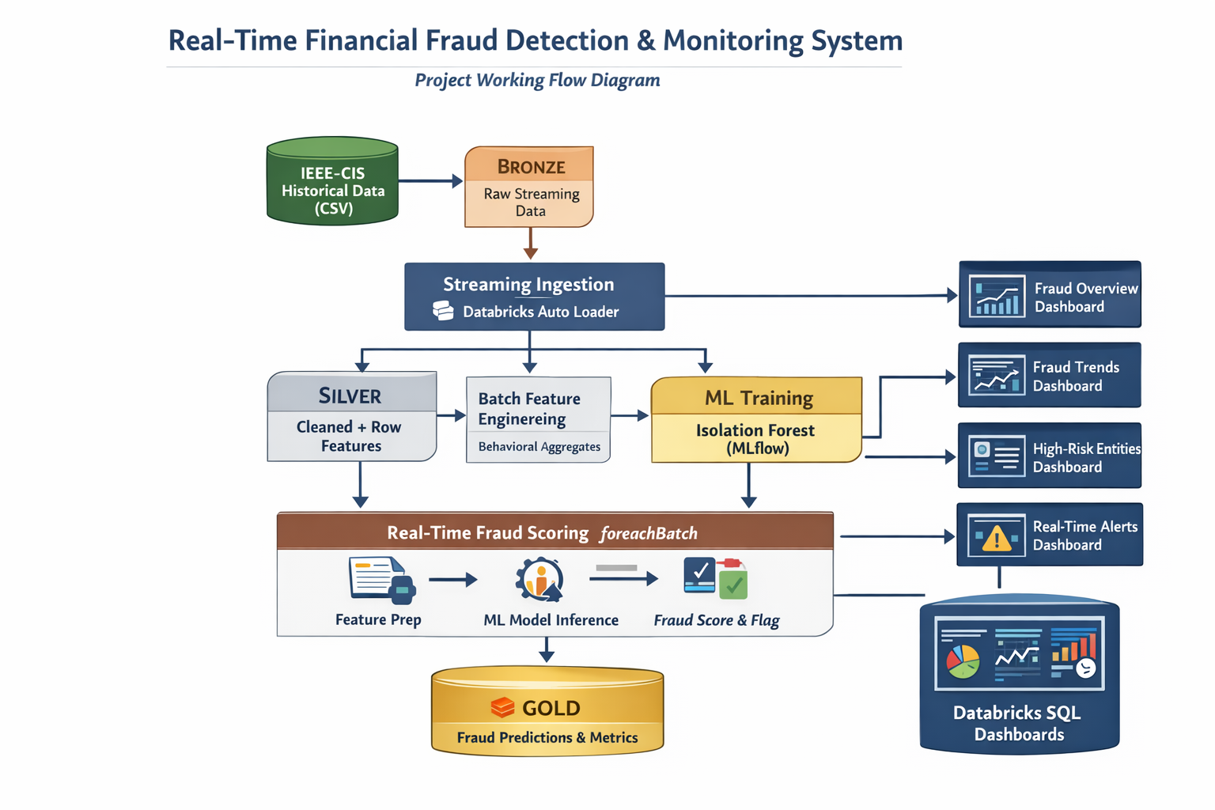

Slide 6
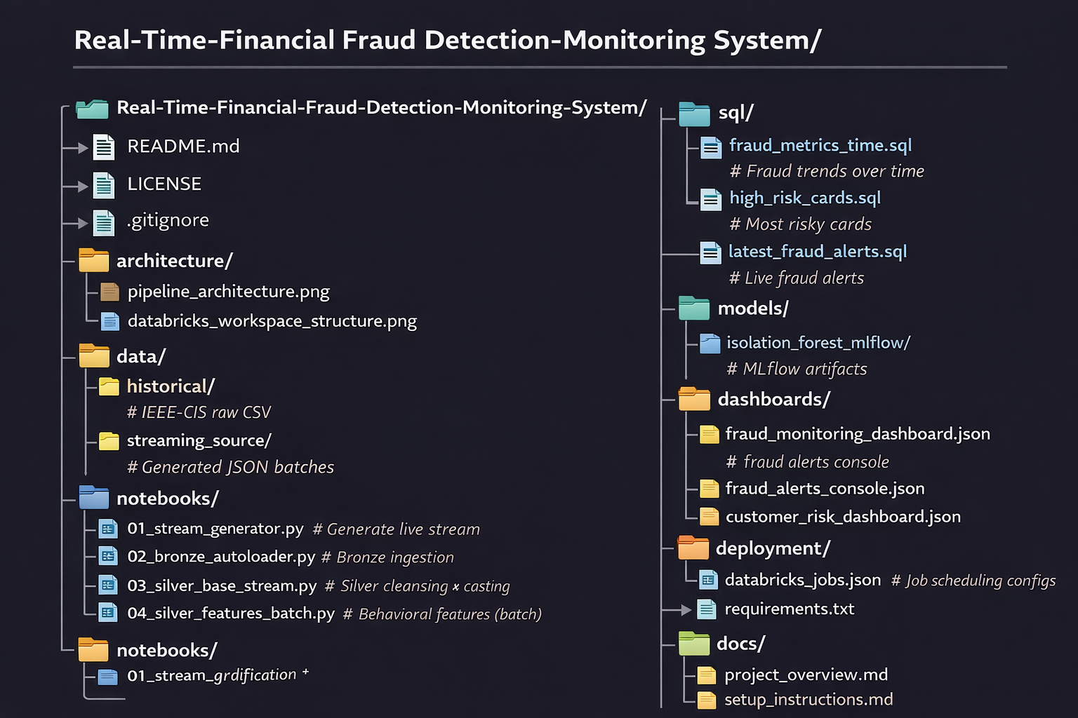
Project File & Folder Structure - GitHub Repository

Slide 7
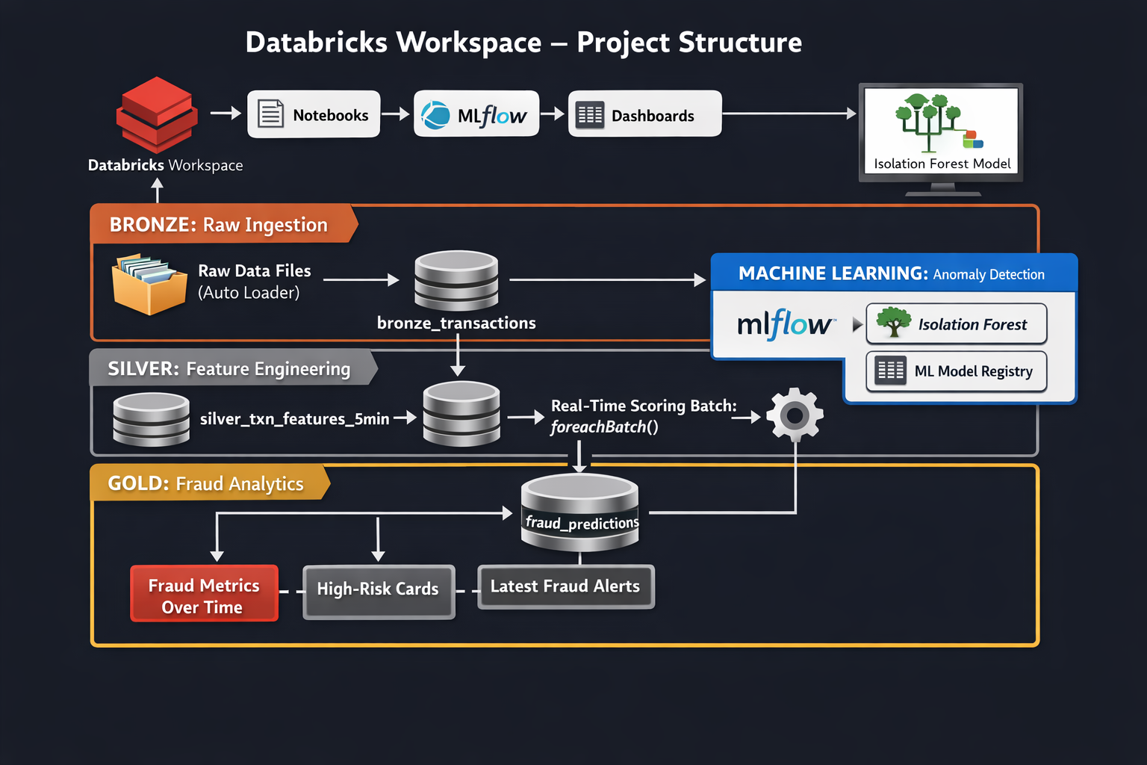

Slide 8
Bronze Layer - Raw Streaming Ingestion
Purpose:
Store raw streaming transactions
Append-only ingestion
Capture ingestion metadata
Technology:
Auto Loader (cloudFiles)
Delta Streaming Tables

Slide 9
Silver Layer - (Cleaning + Feature Engineering)
Purpose:
Type casting and data validation
Enrich transactions with behavioral features
Key Features:
High-value transaction flag
Transaction frequency (5-min window)
Merchant diversity
Amount deviation indicators

Slide 10
Machine Learning - (Isolation Forest + MLflow)
Model:
Isolation Forest anomaly detection
Training:
Offline training on Silver data
Deployment:
Model registered in MLflow Unity Catalog
Alias-based loading (production)

Slide 11
Real-Time Fraud Scoring (Streaming data)
Scoring Process:
Stream transactions from Silver Base
Join with latest behavioral features
Apply ML model using foreachBatch
Output:
Gold fraud_predictions table with fraud_score and anomaly flag

Slide 12
Gold Layer - Metrics & Dashboards
Gold Tables:
Fraud trend metrics over time
High-risk cards ranking
Latest fraud alerts
Dashboards:
Fraud Monitoring Overview
Alerts Console
Customer Risk Profiling

Slide 13
Databricks SQL Dashboards (Real-Time Fraud Monitoring)
We have created 3 Gold metric tables to work with dashboard :
1. Fraud Metrics Over Time
It has major Fields like Total transactions, Fraud transactions and Fraud rate .
It is defined to answer that How many frauds are happening over time.
2. Time-based (minute-level)
It has major Fields like High-Risk Cards, Cards with most frauds and Useful for investigations of frauds.
It is defined to answer that Which cards are most risky in Fraud Transactions.
3. Latest Fraud Alerts
It has major Fields like TransactionID, Card1 and Transaction Amount, it finds the Most recent anomalies and Useful for monitoring.
It is defined to answer that what are the most recent fraud happened right now.

Slide 14
Fraud Or Anomaly Transactions Monitoring Dashboard
What it shows
Total transactions per day or month
Fraud transactions per day or month
Fraud rate (%) over time
Why it matters
Detects sudden fraud spikes
Tracks fraud trends continuously
Supports real-time monitoring
Business value
Early fraud detection
Better operational visibility
Faster response to attacks

Slide 15
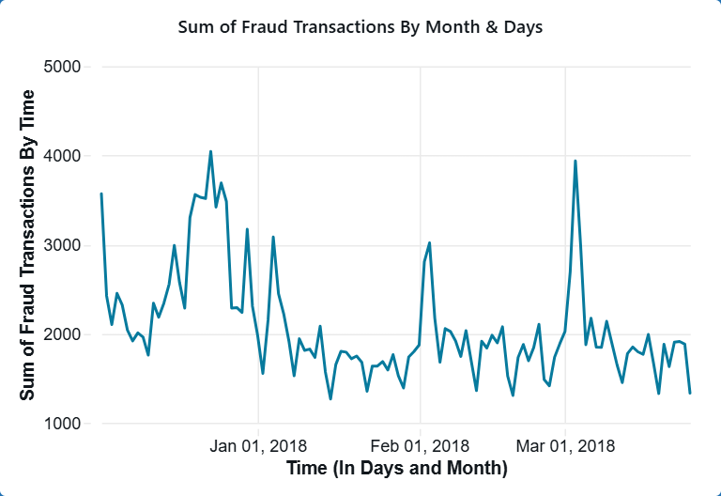

Slide 16
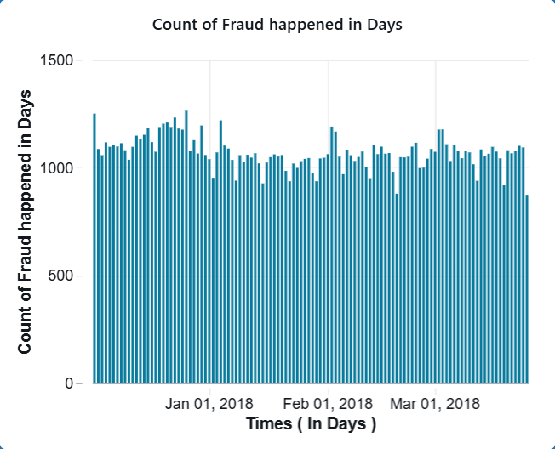

Slide 17
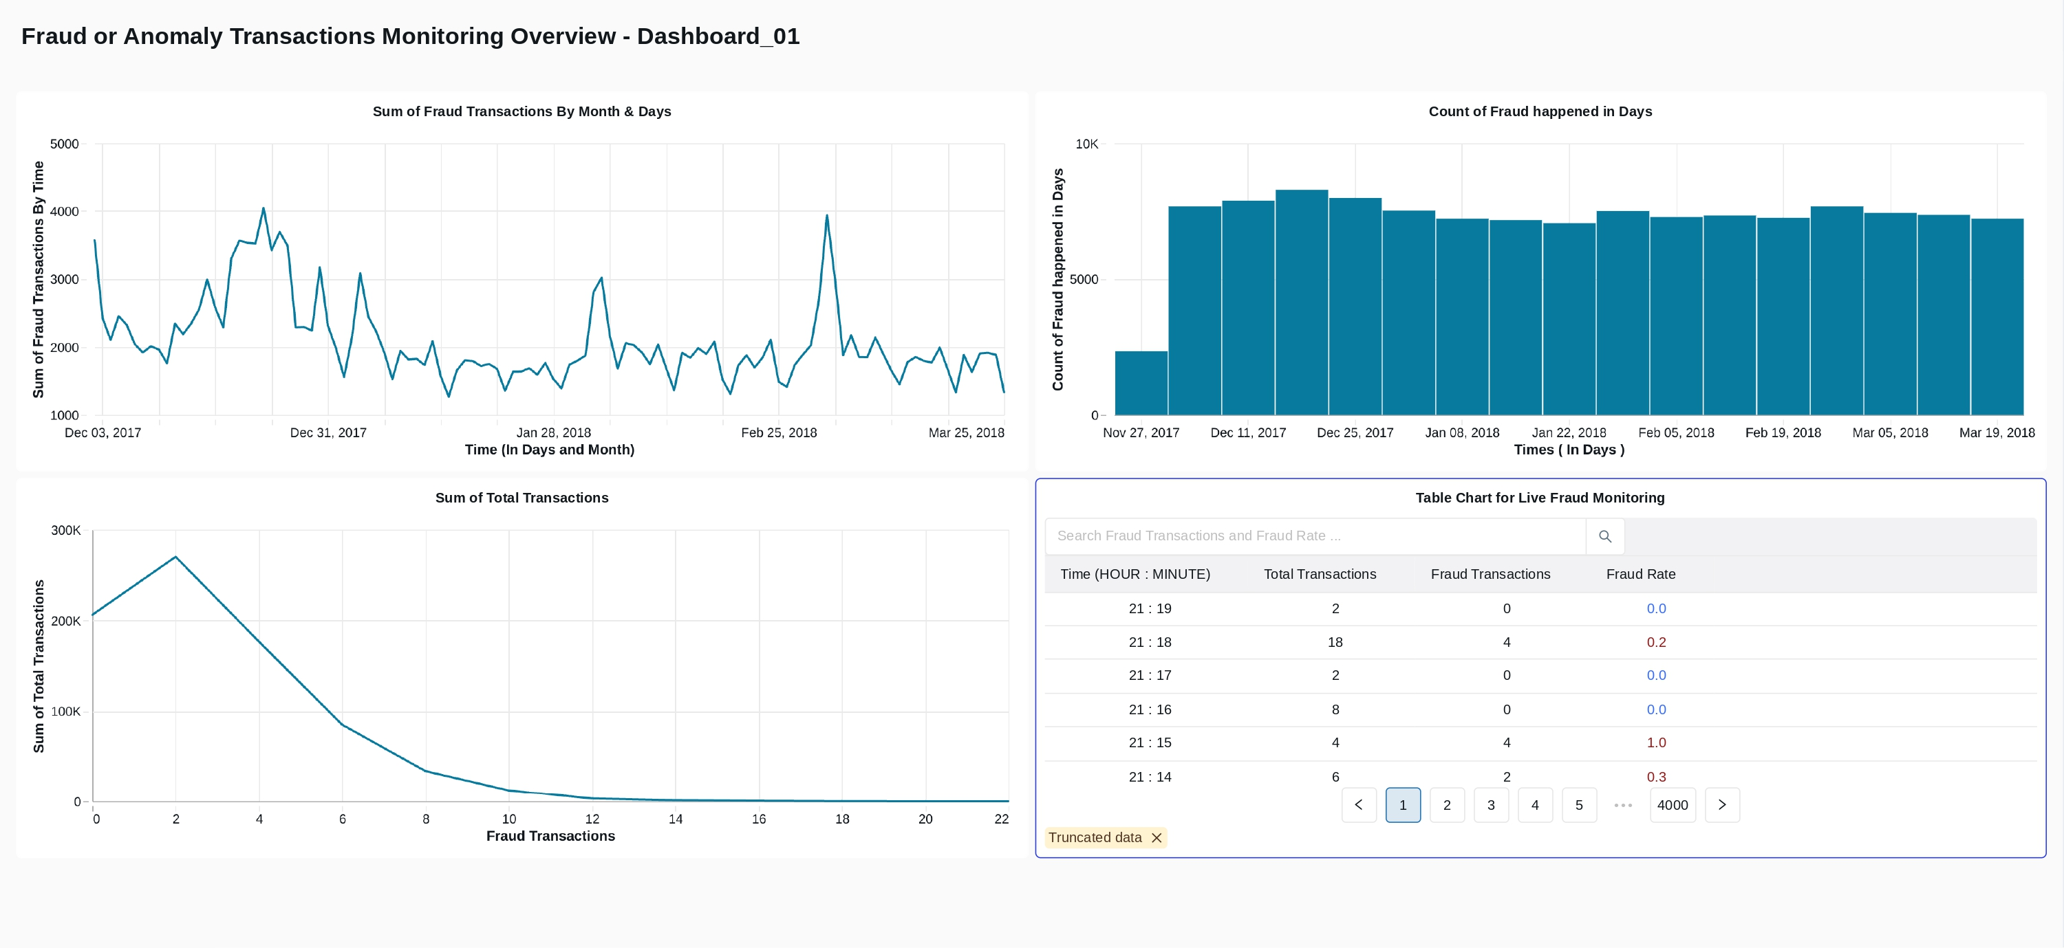

Slide 18
Real-Time Fraud Alerts Count by Cards - Dashboard
What it shows
Cards with most fraud transactions
Total transactions per card
Fraud rate per card
Why it matters
Identifies repeat offenders
Highlights fraud concentration
Prioritizes investigations
Business value
Efficient fraud investigation
Reduced investigation effort
Focus on high-risk entities

Slide 19
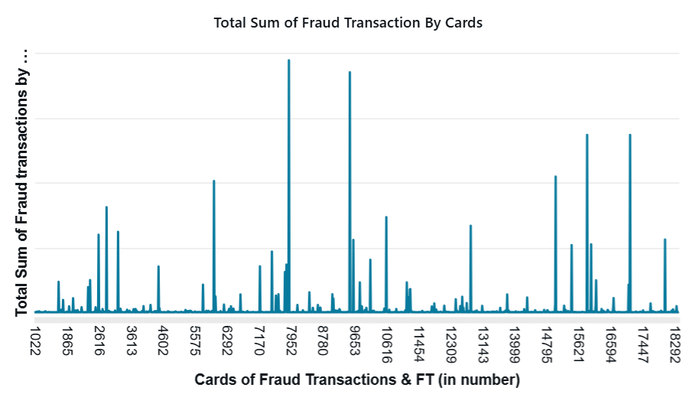

Slide 20
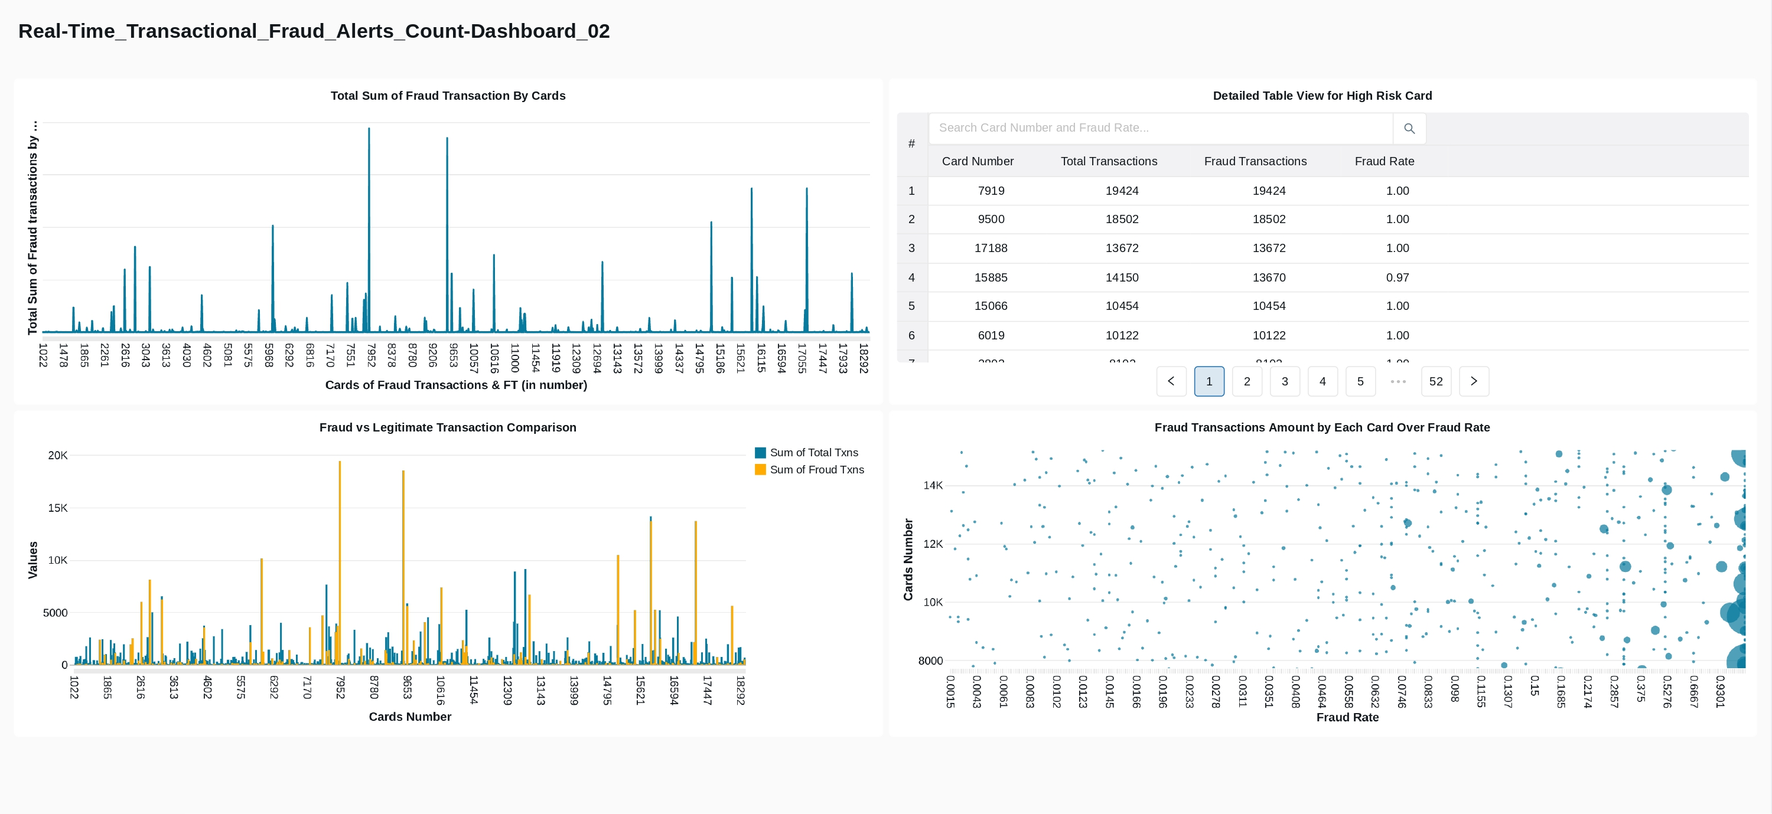

Slide 21
Transactional Fraud Alerts Over Time - Dashboard
What it shows :
Most recent fraudulent transactions
Live anomaly alerts
Transactions sorted by time
Why it matters :
Real-time fraud visibility
Quick detection of active fraud
Immediate operational awareness
Business value :
Faster fraud response
Reduced financial impact
Continuous monitoring

Slide 22
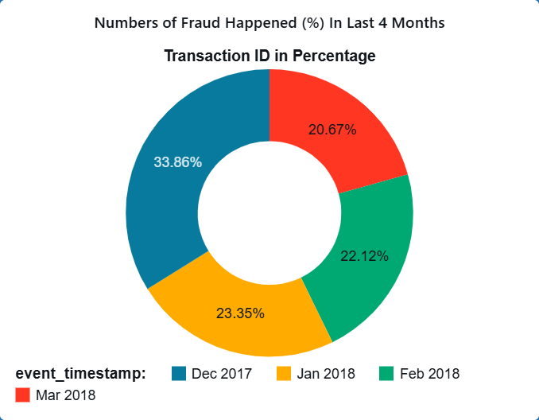

Slide 23
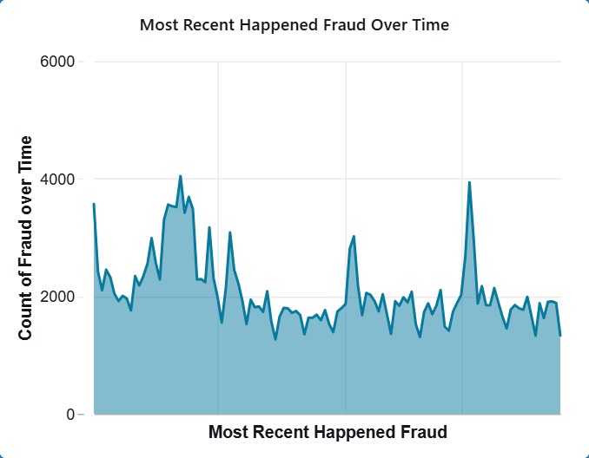

Slide 24
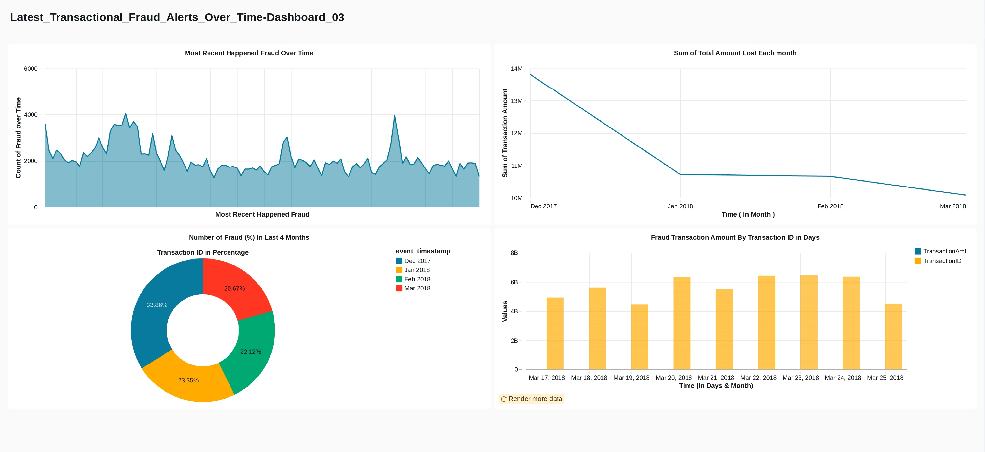

Slide 25
Business Impact & Future Enhancements
Impact:
Real-time fraud visibility
Faster investigation & response
Scalable enterprise-ready architecture
Future Work:
Real-time alerts (email/Slack)
Advanced models (XGBoost, deep learning)
Drift detection & auto-retraining

Slide 26


